Slide 1
Integration
Integration, Substitution & Parts

Slide 2
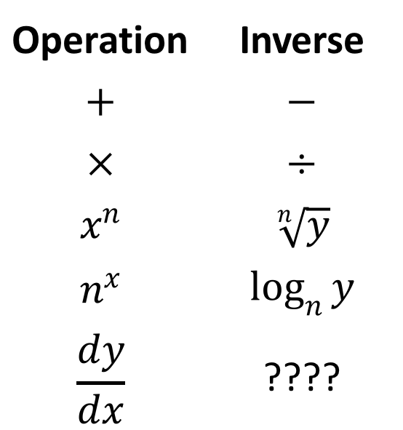
What is Integration?
Everything we’ve learned about until now has an inverse.
Operation | Inverse
$$+$$ | $$−$$
$$×$$ | $$÷$$
$$x^{n}$$ | $$\sqrt[n]{y}$$
$$n^{x}$$ | $$\log_{n}{y}$$
$$\frac{dy}{dx}$$ | ????

Slide 3



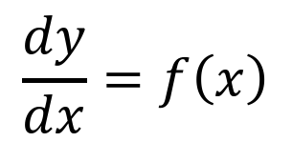
What is Integration?
$$\frac{dy}{dx}=f\left(x\right)$$
$$dy=f\left(x\right).dx$$
$$∫dy=∫f\left(x\right).dx$$
$$y=∫f\left(x\right).dx$$

Slide 4
What is Integration?
(Definite) Integration also gives us the area under a curve:

Slide 5

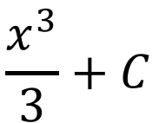
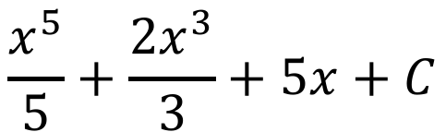
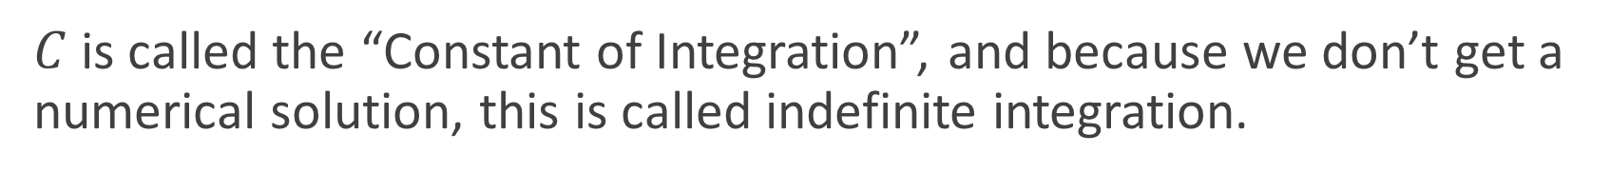

Recap
$$\frac{x^{3}}{3}+C$$
$$∫x^{2}.dx=$$
$$\frac{x^{5}}{5}+\frac{2x^{3}}{3}+5x+C$$
$$∫x^{4}+2x^{2}+5.dx=$$
$C$is called the “Constant of Integration”, and because we don’t get a numerical solution, this is called indefinite integration.

Slide 6
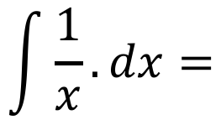

Special Case
$$\int{\frac{1}{x}}.dx=$$
$$\ln{|x|}+C$$
Don’t forget the absolute value signs!

Slide 7

New Basics
This year, we can add a few more “basics” to the list, thanks to the tables on your formula sheet.
We just read the differentiation columns backwards.
$$∫{\cos{x}}.dx=\sin{x}+C$$

Slide 8
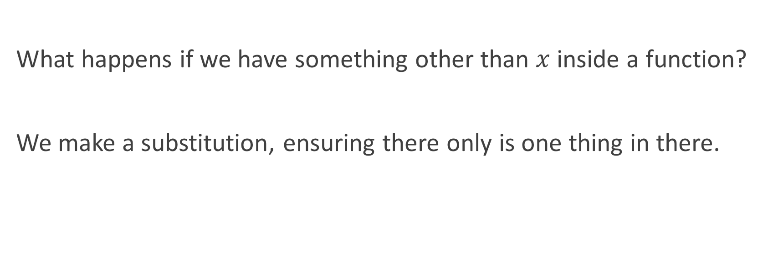
Substitution
What happens if we have something other than $x$inside a function?
We make a substitution, ensuring there only is one thing in there.

Slide 9

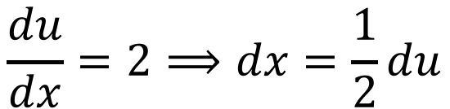
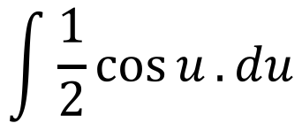
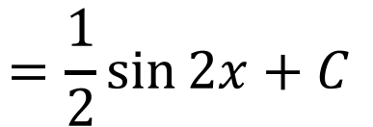
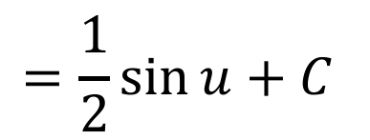
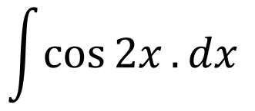
Example 1
Integrate the following equation.
$$\int{\cos{2x}}.dx$$
$$u=2x$$
$$\frac{du}{dx}=2⟹dx=\frac{1}{2}du$$
$$\int{\frac{1}{2}cos{u}}.du$$
$$=\frac{1}{2}\sin{u}+C$$
$$=\frac{1}{2}\sin{2x}+C$$

Slide 10

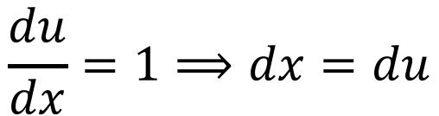

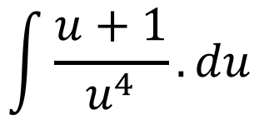
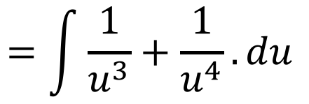
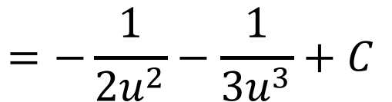
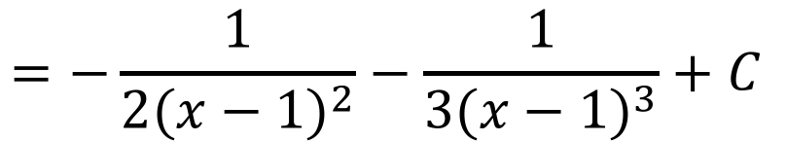
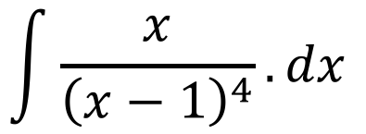
Example 2
Integrate the following equation.
$$\int{\frac{x}{{\left(x−1\right)}^{4}}}.dx$$
$$\frac{du}{dx}=1⟹dx=du$$
$$u=x−1$$
$$x=u+1$$
$$\int{\frac{u+1}{u^{4}}}.du$$
$$=\int{\frac{1}{u^{3}}+\frac{1}{u^{4}}}.du$$
$$=−\frac{1}{2u^{2}}−\frac{1}{3u^{3}}+C$$
$$=−\frac{1}{2{(x−1)}^{2}}−\frac{1}{3{(x−1)}^{3}}+C$$

Slide 11

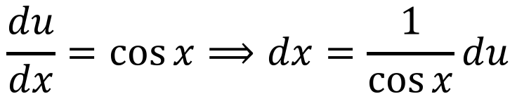
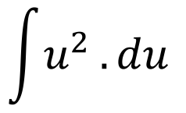
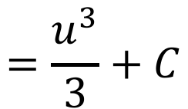
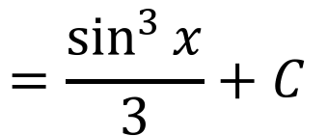
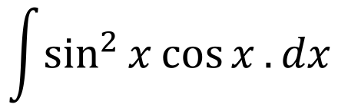
Example 3
Integrate the following equation.
$$\int{\sin^{2}{x}\cos{x}}.dx$$
$$u=\sin{x}$$
$$\frac{du}{dx}=\cos{x}⟹dx=\frac{1}{\cos{x}}du$$
$$\int{u^{2}}.du$$
$$=\frac{u^{3}}{3}+C$$
$$=\frac{\sin^{3}{x}}{3}+C$$

Slide 12
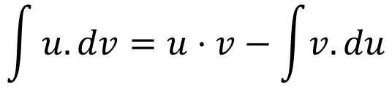
Integration by Parts
This is NOT on your formula sheet – you’ll just have to remember this one.
Some questions are just too tricky to solve by substitution.
These questions usually came from a product rule differentiation.
We need a new technique, and it’s called integration by parts.
$$\int{u.dv=u⋅v−\int{v.du}}$$

Slide 13

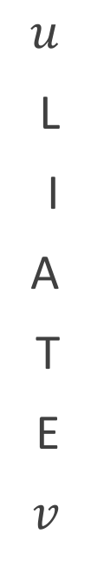
Choosing $u$ and $v$
Also not on your formula sheet – there’s lots to remember here ☹
$u$
L
I
A
T
E
$v$
ogarithmic
nverse trigonometric
lgebraic
rigonometric
xponential

Slide 14


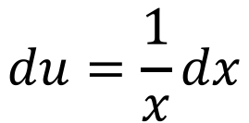

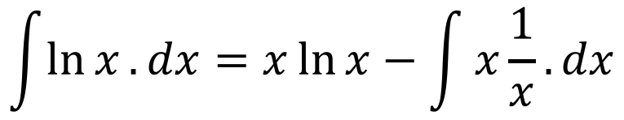

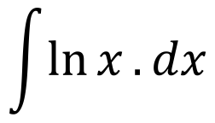
Example 1
Integrate the following equation.
$$\int{\ln{x}.dx}$$
$$u=\ln{x}$$
$$dv=dx$$
$$du=\frac{1}{x}dx$$
$$v=x$$
$$\int{\ln{x}.dx}=x\ln{x}−\int{x\frac{1}{x}}.dx$$
$$=x\ln{x}−x+C$$

Slide 15



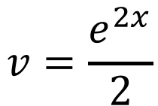
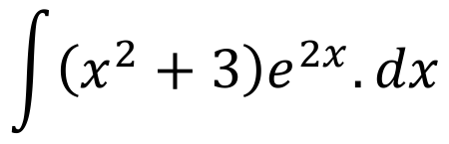
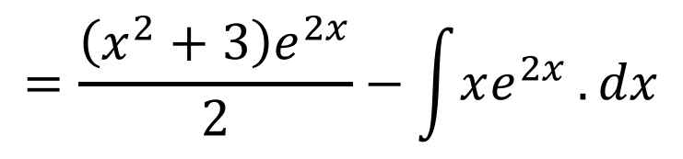
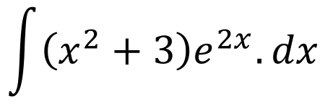
Example 2
Integrate the following equation.
$$\int{\left(x^{2}+3\right)e^{2x}.dx}$$
$$u=x^{2}+3$$
$$dv=e^{2x}.dx$$
Integration by Substitution
$$du=2x .dx$$
$$v=\frac{e^{2x}}{2}$$
$$\int{\left(x^{2}+3\right)e^{2x}.dx}$$
$$=\frac{\left(x^{2}+3\right)e^{2x}}{2}−\int{xe^{2x}}.dx$$
Integration by Parts, again!

Slide 16



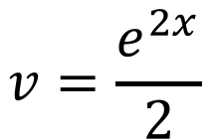
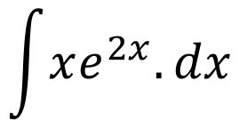
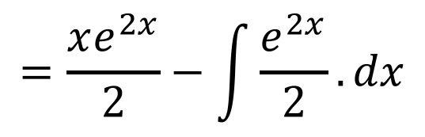
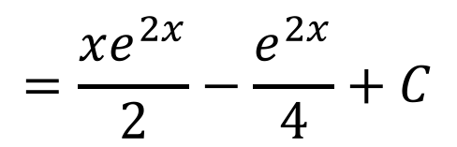
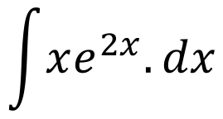
Example 2, continued…
Integrate the following equation.
$$\int{xe^{2x}.dx}$$
$$u=x$$
$$dv=e^{2x}.dx$$
Integration by Substitution
$$du=dx$$
$$v=\frac{e^{2x}}{2}$$
$$\int{xe^{2x}.dx}$$
$$=\frac{xe^{2x}}{2}−\int{\frac{e^{2x}}{2}}.dx$$
$$=\frac{xe^{2x}}{2}−\frac{e^{2x}}{4}+C$$

Slide 17
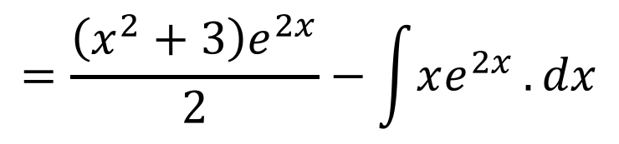
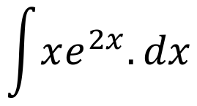
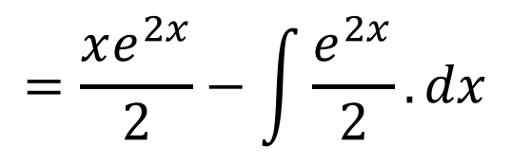
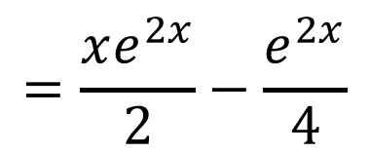
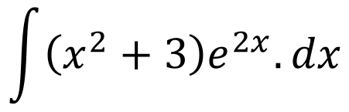
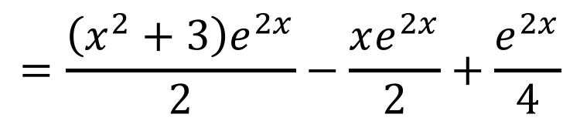
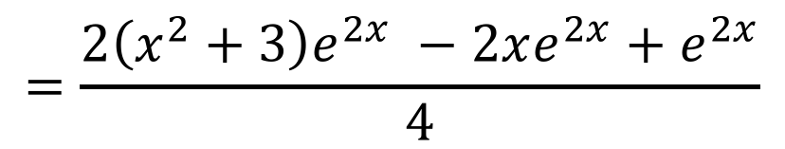
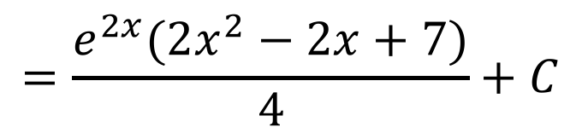
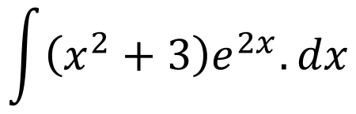
Example 2, continued…
$$\int{\left(x^{2}+3\right)e^{2x}.dx}$$
$$=\frac{\left(x^{2}+3\right)e^{2x}}{2}−\int{xe^{2x}}.dx$$
$$\int{xe^{2x}.dx}$$
$$=\frac{xe^{2x}}{2}−\int{\frac{e^{2x}}{2}}.dx$$
$$=\frac{xe^{2x}}{2}−\frac{e^{2x}}{4}$$
$$\int{\left(x^{2}+3\right)e^{2x}.dx}$$
$$=\frac{\left(x^{2}+3\right)e^{2x}}{2}−\frac{xe^{2x}}{2}+\frac{e^{2x}}{4}$$
$$=\frac{2\left(x^{2}+3\right)e^{2x} −2xe^{2x}+e^{2x}}{4}$$
$$=\frac{e^{2x}(2x^{2}−2x+7)}{4}+C$$

Slide 18
Definite Integration
Now we can integrate most functions, how do we actually find the area under these curves?
We perform definite integration.

Slide 19



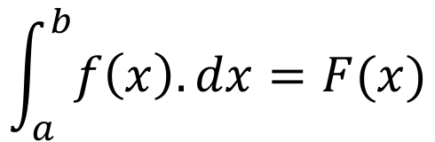
Definite Integration
$$\int_{a}^{b}{f\left(x\right).dx}=F(x)$$
$$b$$
$$a$$
$$=F\left(b\right)−F(a)$$

Slide 20
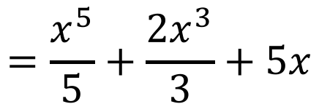



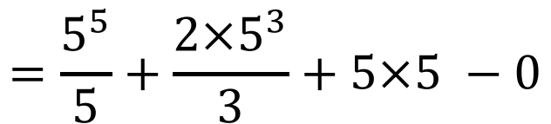
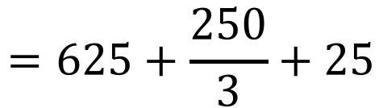


Example
Find the area under the curve between 0 and 5.
$$x^{4}+2x^{2}+5$$
$$\int_{0}^{5}{x^{4}+2x^{2}+5}.dx$$
$$=\frac{x^{5}}{5}+\frac{2x^{3}}{3}+5x$$
$$5$$
$$0$$
$$=\frac{5^{5}}{5}+\frac{2×5^{3}}{3}+5×5 −0$$
$$=625+\frac{250}{3}+25$$
$$=\frac{2200}{3}$$

Slide 21
Do Now
Any Questions?
Delta Workbook
Exercises 16.1 – 20.4
Workbook
Pages 129-131, 141-143

Slide 22

This work is licensed under a Creative Commons Attribution-NonCommercial-ShareAlike 4.0 International License.
Aaron Stockdill
2016

